Slide 1
Registry Integration:
STS Import Tool

Slide 2
Contents
STS and MPOG Data Merge Overview
Preparing for MPOG/STS Integration
Importing STS Data to MPOG

Slide 3
STS and MPOG Integration Overview
*Sites interested in merging their STS data with MPOG must first submit an application. See our website for more information.

Slide 4
Integrating STS Data with MPOG Data
Optional for sites that are interested in integrating their surgical registry data with their MPOG data. Sites must also participate with the Society of Thoracic Surgeons (STS) registry to be eligible to perform this merge.
  STS – Adult Cardiac (STS-ACSD) “STS Cardiac”
  STS – General Thoracic (STS-GTSD) “STS Thoracic”
  STS – Congenital Heart (STS-CHSD) – Not currently available for MPOG Merge
  STS – Intermacs (LVAD database) – Not currently available for MPOG Merge
If your site would like to start integrating your STS data with MPOG, please visit our website to fill out an application and begin the process.

Slide 5
Preparing for MPOG/STS Integration

Slide 6
Obtain STS Harvest File
Whether your Institution is submitting STS Cardiac and/or STS Thoracic data, you must first obtain the appropriate Harvest File
  Work with your Institution’s STS Surgical Clinical Reviewer (SCR) to obtain a copy of the file.
    Determine cadence for how often this file will be provided and how you will receive it from the STS SCR
STS uploads to MPOG should be completed Quarterly (February, May, August, and November)
See next slide for STS Harvest Schedule dates

Slide 7
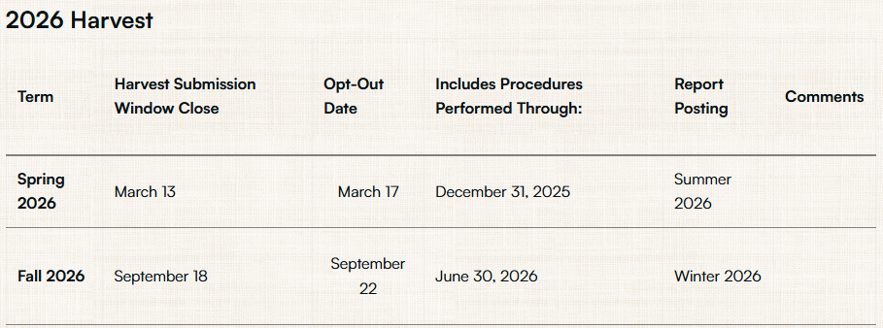
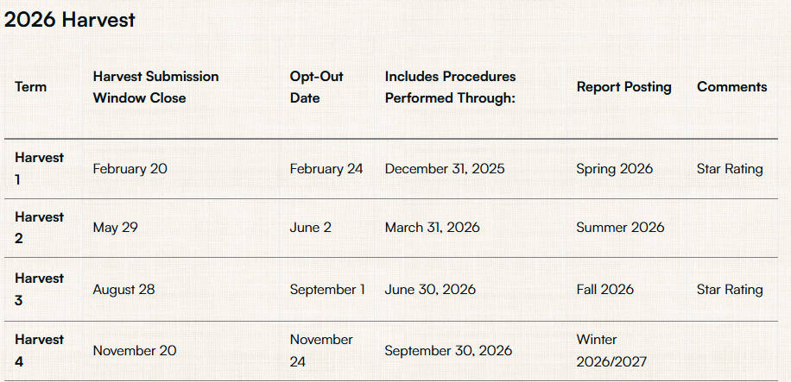
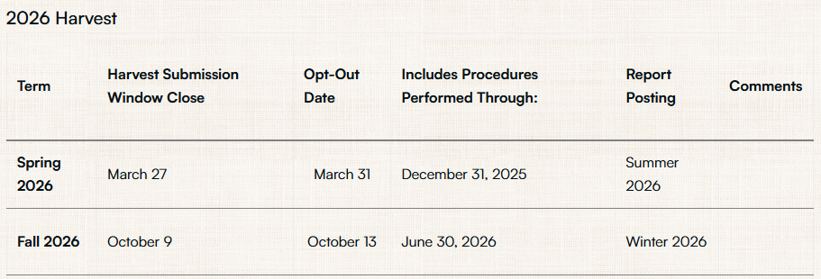
STS Harvest Schedule
General Thoracic Surgery Database
Adult Cardiac Surgery Database
Congenital Heart Surgery Database
Most recent STS Harvest schedule available here

Slide 8
Importing STS Data to MPOG

Slide 9
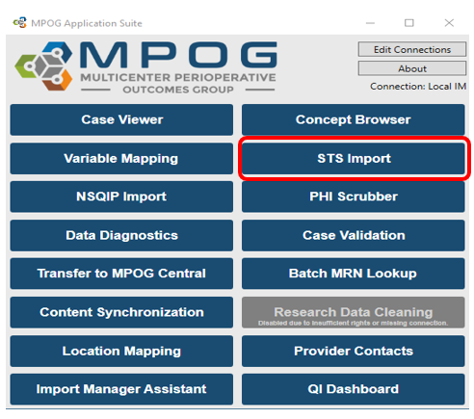
MPOG App Suite: STS Import Utility
Once you have a harvest file, use the MPOG Application Suite to input this data into your local MPOG database.
  The data can then be PHI scrubbed and transferred to the MPOG Central repository.
Open the STS Import application

Slide 10
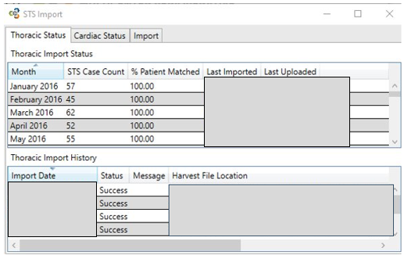
Using the STS Import Utility
The first screen will show you the import status including:
Number of Cases
What percentage of those STS records have been patient-matched locally
Which months of data have been imported
Date of last upload
Click on the ‘Import’ tab to start an import of a harvest file

Slide 11
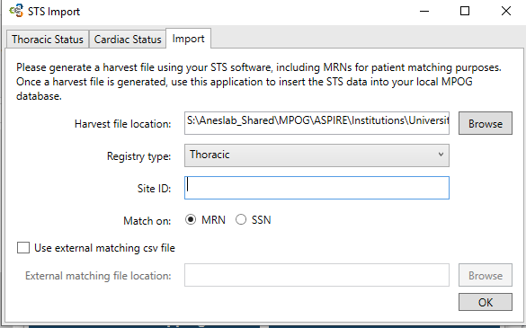
STS Import
Locate your STS harvest file using the “Browse” button
Select the appropriate Registry Type (Thoracic or Cardiac)
Enter your Site ID
  If you do not know this, contact your Institution’s STS SCR
Select if you are going to match on MRN or SSN (MRN preferred)
‘Use the external matching CSV file’ should only be used if MRNs or SSNs are not populated directly within the harvest file

Slide 12
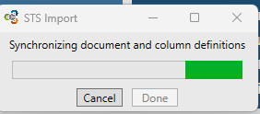
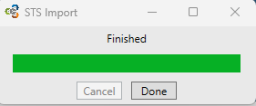
STS Import Completion
Click ‘OK’ to start the import process
  The process will import the STS data into the local MPOG database, perform patient matching, and set any PHI scrubber flags and transfer flags appropriately.
A popup window shows the STS Import progress and completion
If you receive any errors, please contact support@mpog.zendesk.com

Slide 13
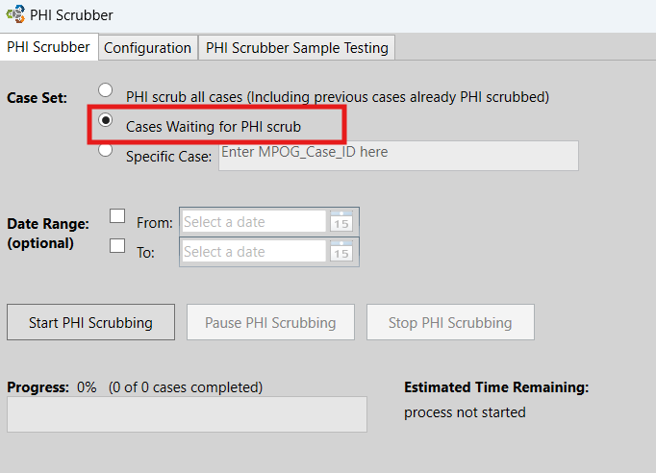
PHI Scrub
After the Import process is complete, please run the PHI scrubber on “Cases Waiting for PHI scrub”
Optional: enter the date range of the STS cases to be transferred
  Depending on the amount of data that needs to be scrubbed, selecting the specific date range may decrease the amount of time for scrubbing to complete.

Slide 14
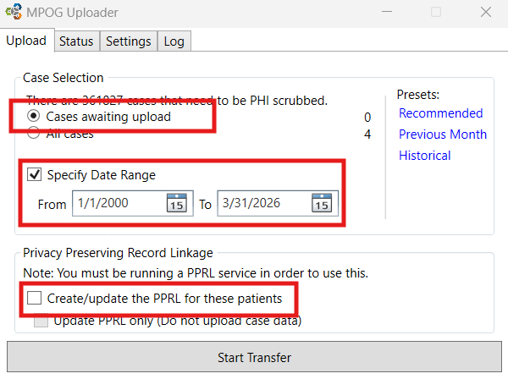
Transfer to MPOG Central
To transfer the scrubbed STS records, use the Transfer to MPOG Central application.
  Select ‘Cases awaiting upload’
  Enter the dates that you want to transfer in the ‘Specify Date Range’ section.
  Unselect the check box for ‘Create/update the PPRL for these patients’

Slide 15
MPOG Technical Support
Contact support@mpog.zendesk.com for any technical assistance with the STS import application

